Slide 1
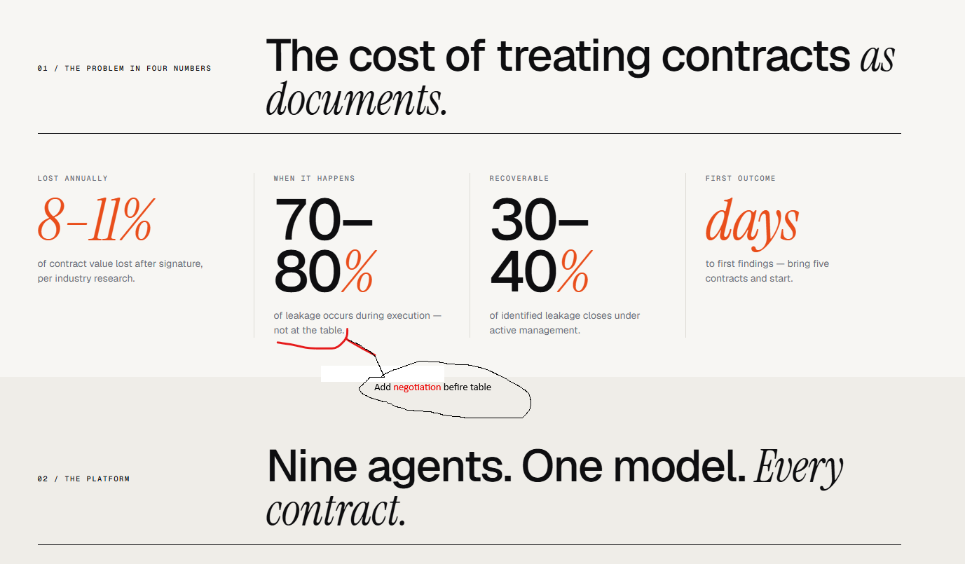

Slide 2
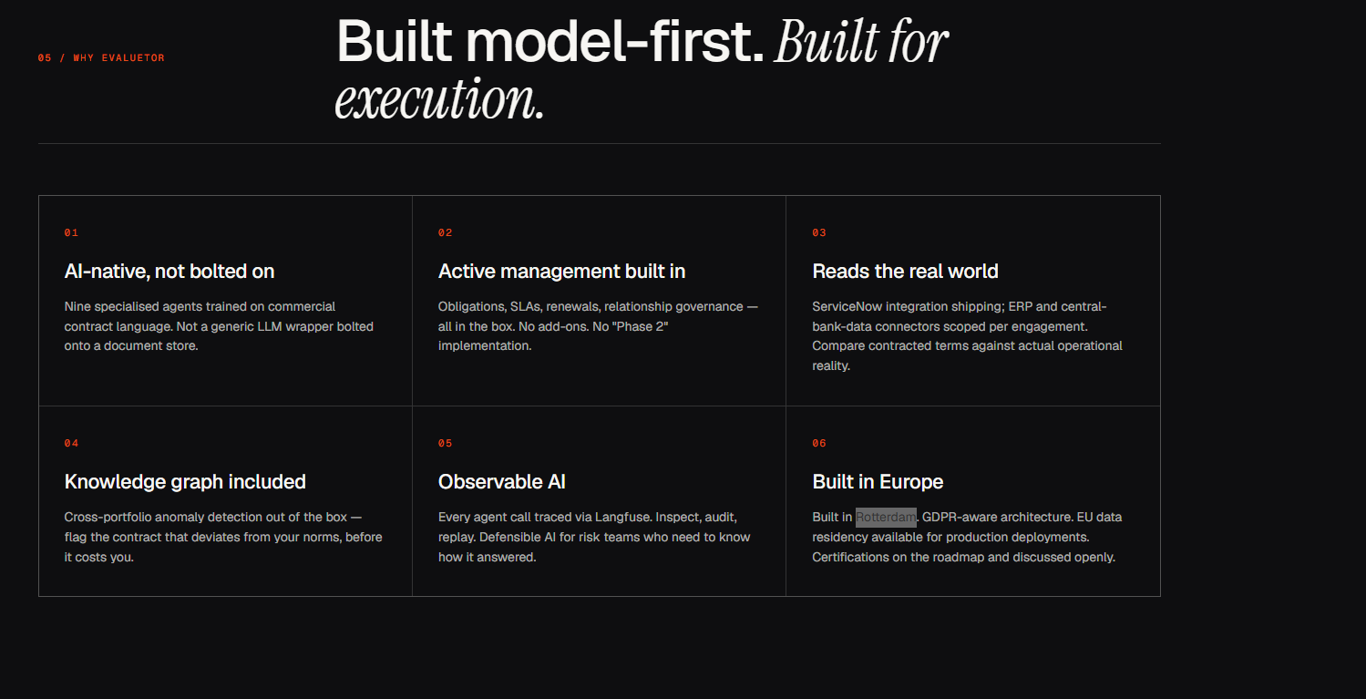
Change Rotterdam into the Netherlands

Slide 3
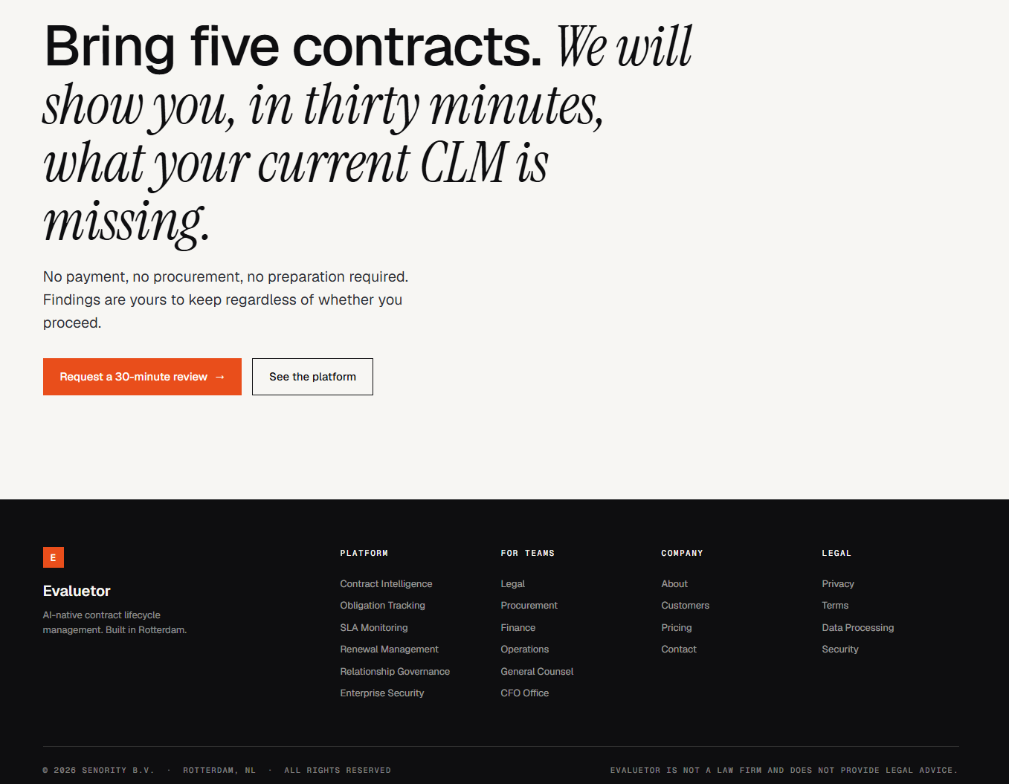
Replace Senority by Evaluetor B.V.

Slide 4
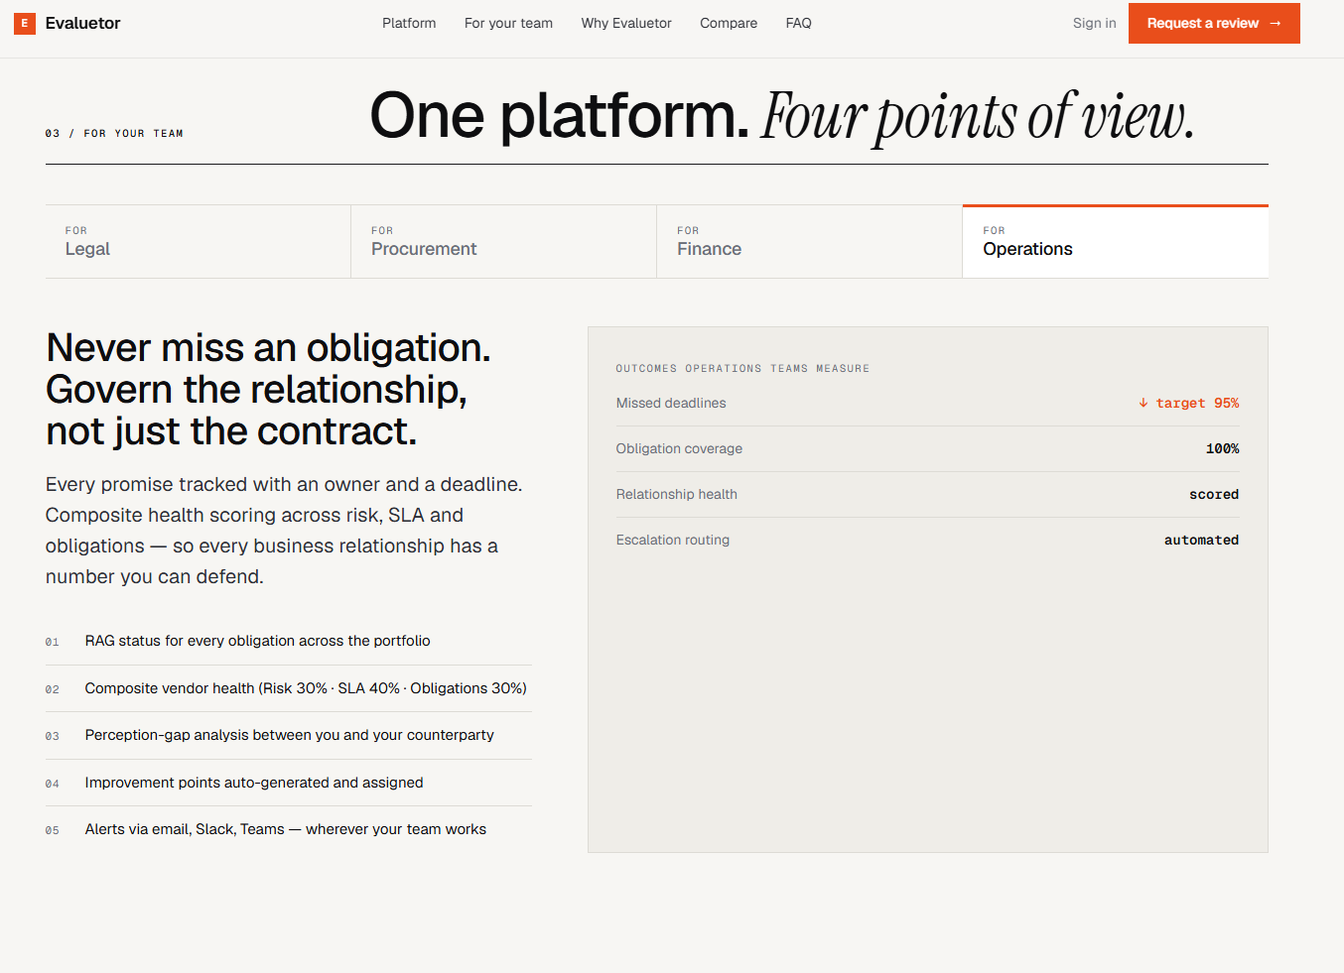
I like the different views, we should add sales/account management/Commercial for a companies SELL side
Current text seems to focus on buy side…. Where you manage Cost, on the sell side you manage Revenue and Contribution … both sides matter
Improves client satisfaction, improve trust, do as your promised, deliver as agreed….
Maybe improve contrast (grey on Grey) & increase font a bit …. Or are it just my eyes ;-)

Slide 5
What did co-pilot read ….
I’ve carefully reviewed your uploaded page ([commercial-combo-mockup.html](https://sevisserconsultancybv-my.sharepoint.com/personal/steven_visser_sevisser_com/Documents/Microsoft%20Copilot%20Chat%20Files/commercial-combo-mockup.html?EntityRepresentationId=30f20e83-13e3-4707-8bcf-ca45a75af89a)) and here is a **clear, structured conclusion**—tailored to your background in CLM, contract value leakage, and board-level thinking.
***
# 🧠 Overall conclusion
This is a **highly sophisticated commercial landing page for a next-generation CLM platform (“Evaluetor”)** with a very specific positioning:
👉 It is **not “just another CLM tool”**
👉 It is positioned as an **AI-native execution intelligence layer**
👉 Its core thesis: **contract value is lost after signature — and existing CLM tools don’t solve that**
***
# 🎯 1. Core strategic positioning
The **central claim** is extremely clear:
> **“8–11% of contract value is lost post-signature”** [\[commercial...mbo-mockup \| HTML\]](https://sevisserconsultancybv-my.sharepoint.com/personal/steven_visser_sevisser_com/Documents/Microsoft%20Copilot%20Chat%20Files/commercial-combo-mockup.html)
And more importantly:
> **70–80% of that loss happens during execution, not negotiation** [\[commercial...mbo-mockup \| HTML\]](https://sevisserconsultancybv-my.sharepoint.com/personal/steven_visser_sevisser_com/Documents/Microsoft%20Copilot%20Chat%20Files/commercial-combo-mockup.html)
### What this means strategically
* This product is **not competing in drafting/workflow CLM**
* It is going after the **“execution gap” → value leakage**
* It reframes CLM from:
* ❌ Document system
* ✅ **Value recovery & operational control system**
👉 This aligns very closely with the concept you often explore:
**contract value leakage prevention as a board-level KPI**
***
# 🧩 2. Product concept (what it really is)
Behind the marketing, the product is essentially:
### 👉 A post-signature contract intelligence layer with 6 pillars:
1. Contract intelligence (AI extraction + risk scoring)
2. Obligation tracking
3. SLA monitoring
4. Renewal management
5. Relationship governance (differentiator)
6. Enterprise security [\[commercial...mbo-mockup \| HTML\]](https://sevisserconsultancybv-my.sharepoint.com/personal/steven_visser_sevisser_com/Documents/Microsoft%20Copilot%20Chat%20Files/commercial-combo-mockup.html)
### Key architectural claim:
> “Nine AI agents… every contract” [\[commercial...mbo-mockup \| HTML\]](https://sevisserconsultancybv-my.sharepoint.com/personal/steven_visser_sevisser_com/Documents/Microsoft%20Copilot%20Chat%20Files/commercial-combo-mockup.html)
### My interpretation
This suggests:
* Multi-agent LLM orchestration
* Structured extraction + monitoring + alerting
* Strong focus on **operational triggers** (not static analysis)
***
# ⚠️ 3. The real differentiator (important)
The **single most important differentiator** is:
### 👉 “Relationship Governance”
> Including perception gap + health scoring [\[commercial...mbo-mockup \| HTML\]](https://sevisserconsultancybv-my.sharepoint.com/personal/steven_visser_sevisser_com/Documents/Microsoft%20Copilot%20Chat%20Files/commercial-combo-mockup.html)
This is **not standard in CLM tools**.
### Why this matters (your lens)
* Moves from:
* contract → compliance
* to:
* contract → **commercial performance + relationship quality**
* Bridges **legal, procurement, and operations**
👉 In board terms:
**This is where CLM becomes a business performance system**
***
# 📊 4. Strong commercial narrative (well-crafted)
The website is very well structured commercially:
### A. Problem framing
* Quantified leakage (8–11%)
* Execution-phase focus
### B. Visual storytelling
* Value erosion curve
* Leakage points (SLA breach, scope change, missed deadlines, etc.) [\[commercial...mbo-mockup \| HTML\]](https://sevisserconsultancybv-my.sharepoint.com/personal/steven_visser_sevisser_com/Documents/Microsoft%20Copilot%20Chat%20Files/commercial-combo-mockup.html)
### C. Role-based value propositions
* Legal → speed + risk visibility
* Procurement → recover credits
* Finance → forecast vs contracts
* Operations → obligation tracking [\[commercial...mbo-mockup \| HTML\]](https://sevisserconsultancybv-my.sharepoint.com/personal/steven_visser_sevisser_com/Documents/Microsoft%20Copilot%20Chat%20Files/commercial-combo-mockup.html)
👉 This is **very well aligned with enterprise buying committees**
***
# ⚖️ 5. Competitive positioning (very deliberate)
Compared to:
* DocuSign CLM
* Icertis
* Ironclad
The message is:
👉 **They manage contracts → we manage outcomes**
Key contrasts:
* Faster time to value (weeks vs months)
* Built-in AI vs add-ons
* Execution monitoring (SLA, obligations) not standard elsewhere [\[commercial...mbo-mockup \| HTML\]](https://sevisserconsultancybv-my.sharepoint.com/personal/steven_visser_sevisser_com/Documents/Microsoft%20Copilot%20Chat%20Files/commercial-combo-mockup.html)
### My realistic interpretation
* Some claims are **aggressive (marketing-driven)**
* But the **direction is credible and strategically strong**
***
# 🚨 6. Critical observations (important for you)
Here are the **real-world questions you should ask as an expert**:
### 1. Data integration complexity
They mention:
* ERP
* ITSM
* SLA data feeds [\[commercial...mbo-mockup \| HTML\]](https://sevisserconsultancybv-my.sharepoint.com/personal/steven_visser_sevisser_com/Documents/Microsoft%20Copilot%20Chat%20Files/commercial-combo-mockup.html)
👉 In reality:
This is **the hardest part of the entire solution**
***
### 2. Accuracy vs risk exposure
They say:
* Human-in-the-loop initially
* Audit trails via Langfuse [\[commercial...mbo-mockup \| HTML\]](https://sevisserconsultancybv-my.sharepoint.com/personal/steven_visser_sevisser_com/Documents/Microsoft%20Copilot%20Chat%20Files/commercial-combo-mockup.html)
👉 Key concern:
* Legal/compliance teams need **near-perfect precision**
* Especially for:
* liabilities
* penalties
* obligations
***
### 3. Scalability of “relationship governance”
Very interesting concept — but:
👉 Hard questions:
* How is “perception gap” measured?
* Based on surveys? signals? emails?
This could either be:
* ✅ breakthrough
* ❌ vague / unscalable feature
***
### 4. Market maturity mismatch
Most organisations still:
* struggle with basic CLM
This product assumes:
* structured contracts
* available operational data
* cross-functional maturity
👉 So:
**Target market = mid-to-large, relatively mature buyers**
***
# 💡 7. My bottom-line judgement (straight)
### ✅ What’s strong
* Excellent positioning (execution > drafting)
* Very relevant problem (value leakage)
* Clear differentiation vs legacy CLM
* Strong commercial storytelling
* Aligns with CFO / procurement agenda
### ⚠️ What’s uncertain
* Real integration effort
* AI accuracy at scale
* Depth of “relationship governance”
* Proof vs concept (early-stage signal: “pilot & early access”) [\[commercial...mbo-mockup \| HTML\]](https://sevisserconsultancybv-my.sharepoint.com/personal/steven_visser_sevisser_com/Documents/Microsoft%20Copilot%20Chat%20Files/commercial-combo-mockup.html)
***
# 🧾 8. What I would conclude (in one sentence)
👉
**This is a well-designed, strategically sharp positioning of a next-gen CLM category (“execution intelligence”), but the real test will be its ability to operationalise data integration and deliver reliable, measurable value recovery at scale.**
***
# 🚀 If you want next step (high value for you)
Given your experience, I can:
✅ Turn this into a **board-ready 1-page positioning slide**
✅ Create a **CLM maturity model vs Evaluetor fit**
✅ Or do a **commercial critique (pricing, GTM, ICP fit)**
Just tell me 👍

Slide 6
sharp, no-nonsense commercial critique of pricing and GTM
Here is a sharp, no-nonsense commercial critique of pricing and GTM for the Evaluetor concept—grounded in how the CLM market actually behaves and tailored to your expertise (value leakage, enterprise sales, board-level positioning).
💰 1. Pricing critique — strong concept, but incomplete execution
✅ What they get right (strategically)
1. Explicit rejection of per-seat pricing
“Pricing based on portfolio size and connector scope, not per seat” [commercial...mbo-mockup | HTML]
This is correct and forward-looking because:
Per-seat pricing breaks in cross-functional tools
CLM must be used by legal, procurement, finance, operations
Per-seat models:
discourage adoption
create internal friction
scale poorly in enterprise environments [sirion.ai]
👉 Your lens: This aligns perfectly with “contract value is enterprise-wide, not user-based”
2. Implicit value-based pricing direction
Their positioning (value leakage recovery, SLA credits, renewal prevention) naturally points to:
👉 Value-based or outcome-based pricing
Which is the correct direction for enterprise SaaS:
Value-based pricing:
aligns with perceived ROI
works best in high-ACV enterprise deals [remery.ai]
❌ Where it falls short (commercially critical)
1. Missing a clear value metric (biggest issue)
They don’t answer:
👉 What exactly are customers paying for?
Examples they could have used:
% of contract value under management
€ value at risk monitored
number of obligations tracked
number of suppliers monitored
👉 Without this:
Pricing feels vague → CFO resistance
Sales cycles become longer
Value narrative becomes harder to quantify
📌 Key rule:
Pricing must map to the same metric as ROI
2. No explicit ROI anchor in pricing
They state:
8–11% leakage
30–40% recoverable [commercial...mbo-mockup | HTML]
But they don’t connect this to pricing
👉 Missed opportunity:
They should say:
“We recover €X → we charge €Y”
or:
“<5–10% of recovered value”
👉 This is exactly how:
audit firms
procurement analytics tools
optimisation platforms price
3. Hidden enterprise pricing reality not addressed
In reality, CLM pricing includes:
subscription
implementation
integrations
support [concord.app]
👉 Their message: “simple engagement, 30-minute review”
👉 Reality:
enterprise implementations often cost:
€100k–€300k year one (benchmark) [hyperstart.com]
⚠️ Risk:
credibility gap with experienced buyers
4. AI pricing expectation gap
Market trend:
55% of buyers expect AI features at no extra cost [cpl.thalesgroup.com]
But Evaluetor heavily sells:
“AI-native”
“9 agents”
👉 Risk:
Customers won’t accept AI as premium pricing justification
Instead, they expect:
outcomes, not tech
💡 Pricing conclusion (your language)
👉 The pricing direction is strategically right (move away from seat-based CLM), but commercially underdeveloped: it lacks a clear value metric, ROI anchor, and enterprise pricing realism—making it harder to close CFO-led deals.
🚀 2. GTM critique — very strong narrative, but execution risk
✅ What they get right (very strong)
1. Excellent category repositioning
They are not selling:
CLM
They are selling: 👉 “post-signature execution intelligence”
This is excellent because:
Legacy CLM = crowded
Execution intelligence = white space
2. CFO-level problem framing
They speak in:
€ value leakage
risk exposure
missed credits
👉 This directly targets:
CFO
procurement leadership
COO
✅ This is much stronger than legal-led selling
3. Multi-stakeholder GTM (correct for enterprise)
They built views for:
Legal
Procurement
Finance
Operations [commercial...mbo-mockup | HTML]
👉 This matches reality:
B2B SaaS requires multiple decision-makers [vehnta.com]
4. Smart entry offer (very strong)
“Bring five contracts → 30-minute review”
👉 This is:
tangible
low friction
ROI-driven
✅ This is a good wedge into enterprise accounts
❌ Where the GTM will struggle (critical)
1. Target market is too wide
They say:
Legal, Procurement, Finance, Ops, CFOs
👉 That is too broad for early GTM
Reality:
Successful SaaS GTM often starts with one vertical persona [saashero.net]
👉 Recommendation (strong):
Start with:
procurement-led enterprises (SLA/credit recovery use case)
Why?
fastest ROI
easiest quantification
shortest sales cycle
2. No clear ICP (ideal customer profile)
Missing:
company size
industry focus
contract type focus
👉 This is dangerous because:
enterprise CLM is extremely vertical-dependent
Example:
telco SLAs ≠ pharma contracts
👉 Without ICP:
messaging becomes generic
sales cycles increase
3. Underestimates integration as GTM blocker
They claim:
“reads ERP, ITSM, etc.”
But reality:
integration is often the #1 failure point in CLM [zefort.com]
👉 GTM gap:
no clear story for:
data onboarding
system integration
time-to-value beyond pilot
4. “Overlay, not replace” positioning creates ambiguity
They say:
“We layer on top of existing CLM”
👉 Good technically — but:
Commercially:
creates confusion:
Who owns the contract process?
What system is primary?
👉 Risk:
budgets already locked in existing CLM
difficult to justify incremental spend
5. No strong land-and-expand model yet
Modern SaaS GTM relies on:
small entry
expansion via usage or value
👉 Their approach:
enterprise review → big sale
But missing:
clear expansion triggers
⚠️ 3. Real GTM challenge (your lens)
👉 This is not a legal tool sale
It is:
transformation sale
cross-functional adoption
behaviour change
➡️ Which implies:
long sales cycles
heavy onboarding
need for executive sponsor
🧾 Final commercial judgement
🧠 Pricing
👉 Conceptually strong (value-based direction), but too vague and not yet operationalised into a scalable pricing model tied to measurable outcomes.
🚀 GTM
👉 Excellent strategic positioning and messaging, but execution risk lies in lack of focus (ICP), integration complexity, and missing expansion mechanics.
💡 If I were advising them (very concrete)
Pricing
Anchor to one metric:
“% of recoverable value identified”
Create 3 tiers:
Monitoring
Recovery
Optimisation
GTM
Start with:
👉 ONE wedge market:
Procurement-led enterprises
High SLA / vendor spend environments
Then expand to:
finance
legal
operations
🔥 Bottom-line (your level, one sentence)
👉 This is a very strong “category creation” play, but to win commercially it must translate its narrative into a sharp ICP, a measurable value-based pricing metric, and a focused land-and-expand GTM motion—otherwise it risks becoming a compelling demo that stalls in procurement.
If you want, I can convert this into: ✅ a board-ready pricing model (with numbers) ✅ or a go-to-market battle plan (first 10 customers + sales motion)

Slide 7
Food for thought on pricing
Excellent—this is exactly the step where most CLM/AI ventures fail or succeed.
Below is a **board-ready pricing model with concrete numbers**, structured the way a CFO, investor, or enterprise buyer would expect it. I’ve translated the concept into a **defensible commercial model tied to value leakage recovery**, not features.
***
# 📊 1. Executive pricing logic (board slide level)
### Core principle
👉 **Price as a function of value protected / recovered (not users, not AI)**
### Anchor numbers (from your own narrative)
* Average contract leakage: **8–11% of contract value**
* Recoverable leakage: **30–40%**
* Typical enterprise portfolio: **€20M – €200M**
***
### 💡 Pricing thesis
👉
**Charge 2–6% of recoverable value → ensuring:**
* 10× ROI for customer
* strong enterprise willingness to pay
* scalable ACV
***
# 💰 2. Concrete pricing model (with numbers)
## A. Value-based core formula
### Step 1 — define recoverable pool
Example customer:
* Annual contract value: €50M
* Leakage (9%): €4.5M
* Recoverable (35%): **€1.6M**
***
### Step 2 — pricing band
👉 Charge:
| Tier | % of recoverable value | Annual fee |
| -------- | ---------------------- | ---------- |
| Entry | 2% | €32k |
| Standard | 4% | €64k |
| Premium | 6% | €96k |
***
👉 CFO logic:
* Pay €64k to recover €1.6M → **25× ROI**
✅ This is extremely compelling
***
## B. Add structural floor pricing (critical)
To avoid underpricing small deals:
### Minimum platform fee
| Segment | Minimum ACV |
| ---------- | ----------- |
| Mid-market | €40k/year |
| Enterprise | €80k/year |
***
👉 This aligns with market benchmarks:
* Enterprise CLM solutions often exceed €90k+ annually [\[bindlegal.com\]](https://bindlegal.com/resources/best-software/clm-for-saas-companies/)
***
# 🧩 3. Packaging model (what you actually sell)
## Tiering (very important for sales)
### 🟢 Tier 1 — Monitoring (Land deal)
**€40k – €60k**
* Contract ingestion + extraction
* Risk scoring
* Renewal alerts
* Basic dashboard
👉 Goal:
* fast entry
* low friction
* prove value
***
### 🟡 Tier 2 — Recovery (Core revenue driver)
**€60k – €120k**
* SLA monitoring
* obligation tracking
* credit calculation
* breach alerts
👉 This is:
**your “money-making tier”**
***
### 🔴 Tier 3 — Optimisation (Strategic upsell)
**€120k – €250k+**
* relationship governance
* vendor scoring
* forecasting
* AI recommendations
👉 Sell to:
* CFO / COO level
***
# ⚙️ 4. Integration & implementation pricing (must be explicit)
This is where many vendors lose margin.
## A. Implementation package
| Scope | Price |
| --------------------- | ------------ |
| Lite (≤ 50 contracts) | €15k |
| Standard | €25k – €50k |
| Enterprise | €50k – €120k |
***
## B. Connector pricing (critical lever)
| Connector | Annual fee |
| ----------------- | ---------- |
| ERP (SAP/Oracle) | €20k |
| ITSM (ServiceNow) | €15k |
| Finance / FX | €10k |
***
👉 Why:
* Integration is real cost driver in CLM [\[hyperstart.com\]](https://www.hyperstart.com/blog/contract-management-software-pricing/)
* Creates natural expansion model
***
# 📈 5. Revenue model example (board-ready)
## Typical mid-enterprise deal
* Contract value: €50M
* Tier: Recovery (4%)
→ Base fee: €64k
→ Implementation: €40k (year 1)
→ Connectors: €30k
### ✅ Total Year 1:
👉 **€134k**
### ✅ Recurring:
👉 **€94k/year**
***
## Enterprise account
* Contract value: €150M
→ Base: €240k
→ Connectors: €50k
👉 **€290k ARR**
***
# 🚀 6. Land-and-expand mechanics (critical for GTM)
## Entry motion
* 5 contracts (pilot)
* €40k package
* 6–8 week deployment
***
## Expansion triggers
| Trigger | Upsell |
| ----------------- | -------------------------- |
| SLA credits found | move to Recovery |
| missed renewals | renewal mgmt module |
| CFO interest | forecasting + optimisation |
| new BU onboarding | +€30k–€100k |
***
✅ This aligns with:
* hybrid SaaS + value-based pricing trends [\[cpl.thalesgroup.com\]](https://cpl.thalesgroup.com/software-monetization/saas-pricing-models)
***
# ⚠️ 7. Pricing risks (board awareness)
### 1. Underpricing risk
* €40k too low → enterprise won’t respect product
👉 Solution:
* enforce minimum €80k for enterprise
***
### 2. ROI proof gap
* customers demand evidence
👉 Solution:
* build “value calculator”
* show:
* € detected leakage
* € recoverable
***
### 3. Complexity creep
* too many pricing variables
👉 Solution:
* keep model simple:
👉 **Base + connectors**
***
# 🧠 8. Strategic recommendation (your level)
## The winning pricing model is:
👉
**Hybrid model = Value-based core + platform floor + integration expansion**
***
### In one line (board-ready)
👉
**“We capture 4% of recoverable contract value with a €80k enterprise floor and €20–50k integration upsell, delivering >10× ROI to customers.”**
***
# 🔥 9. My straight assessment
If implemented like this:
✅ You have:
* €100k–€300k ACV deals
* clear ROI story (CFO-approved)
* scalable enterprise motion
❌ Without it:
* pricing remains “consulting disguised as SaaS”
* deals stall in procurement
***
# 💡 If you want next (highly relevant)
Given your background, I can:
✅ Build a **full revenue model (3-year ARR projection)**
✅ Create a **pricing calculator (Excel-style logic)**
✅ Or design a **deal negotiation playbook (what to say to CFO/procurement)**
Just tell me 👍

Slide 8
CFO Negotiating playbook
Excellent—this is where deals are actually won or lost.
Below is a **board-ready CFO negotiation playbook** for Evaluetor. It is designed for **enterprise negotiations (€80k–€300k ACV)** and aligns tightly with the pricing model we just built.
This is written the way you would actually **arm a sales leader or yourself** in a negotiation.
***
# 🎯 CFO NEGOTIATION PLAYBOOK
**Evaluetor – Value-Based CLM (Execution Intelligence)**
***
# 🧠 1. CFO MINDSET (UNDERSTAND FIRST)
### What the CFO actually cares about:
✅ Not:
* AI agents
* CLM features
* dashboards
✅ But:
* **Cash impact**
* **Forecast reliability**
* **risk avoidance**
* **audit defensibility**
👉 Your framing must always be:
> “This is not software → this is a **P\&L improvement system**.”
***
# ⚙️ 2. OPENING POSITION (HOW YOU START)
## First statement (never skip this)
👉
**“We typically identify €X–€Y of recoverable value per €50M of contract volume. Our fee is a fraction of that.”**
***
### Example (use numbers)
* Contract base: €50M
* Leakage: \~€4.5M
* Recoverable: €1.5M
👉 Say:
> “In similar portfolios, we find €1–2M recoverable value within 6–12 months.
> Our fee is \~€80–100k.”
***
✅ This immediately reframes:
* price → **investment**
* cost → **return multiple**
***
# 💰 3. PRICE DEFENCE FRAMEWORK (THE CORE)
You must always anchor to **three layers**
***
## Layer 1 — ROI multiple
👉 Always lead with:
> “This is a 10–25× ROI decision.”
***
### CFO mental model:
* Anything:
* < 3× → reject
* 5–10× → consider
* > 10× → approve
***
## Layer 2 — Cost of inaction
👉 Quantify the loss:
> “Doing nothing costs you €1–2M per year.”
***
Make it concrete:
* missed SLA credits
* auto-renewals
* pricing leakage
***
## Layer 3 — Budget reframing
👉 Position against wrong budget category:
❌ “CLM software”
✅ “Value recovery / cost optimisation”
***
Say:
> “This should sit next to procurement savings or audit recovery—not IT tooling.”
***
# 💡 4. HANDLING THE 5 REAL CFO OBJECTIONS
***
## ❌ Objection 1: “This is expensive”
### Response:
👉
> “Relative to what?”
Then:
* €80k vs €1.5M recoverable
* €80k vs 1 missed SLA claim
* €80k vs incorrect renewal
👉 Close with:
> “You’re comparing it to software. You should compare it to lost cash.”
***
✅ Never defend price → reframe benchmark
***
## ❌ Objection 2: “We already have a CLM”
### Response:
👉
> “You already have a contract repository.
> What you don’t have is execution visibility.”
Then:
* CLM = storage + workflow
* Evaluetor = € recovery + risk detection
***
👉 Kill switch:
> “If your current CLM can show € recovered / € lost monthly, you don’t need us.”
***
✅ Puts pressure on incumbent
***
## ❌ Objection 3: “Integration will be complex”
### Response:
👉 Acknowledge (don’t fight):
> “Correct—this is where most value sits.”
Then reposition:
> “That’s exactly why the ROI exists. If the data were already connected, the value wouldn’t be leaking.”
***
Then:
* Start with **limited scope**
* expand after proof
***
✅ Turn weakness into justification
***
## ❌ Objection 4: “We need proof before committing”
### Response:
👉
> “Agreed. That’s why we start with 5 contracts.”
Then:
* identify:
* missed obligations
* renewal risks
* SLA gaps
***
👉 Close with:
> “If we don’t find value, you don’t proceed.”
***
✅ Removes buying risk completely
***
## ❌ Objection 5: “Can you discount?”
### Response framework:
NEVER discount first.
***
### Step 1 — anchor value
> “If we reduce scope, we reduce value recovery.”
***
### Step 2 — offer trade-off
Only exchange:
| Give | Get |
| ----------- | ---------------------- |
| Lower price | longer contract (2–3y) |
| Lower price | reference case |
| Lower price | faster decision |
***
### Step 3 — controlled concession
👉
> “We can optimise pricing if we structure this as a multi-year engagement.”
***
✅ Keep price = value integrity
***
# 📊 5. NEGOTIATION LEVERS (WHAT YOU CAN MOVE)
***
## Primary levers
### 1. Scope
* # contracts
* business units
* modules
***
### 2. Time
* pilot vs full rollout
* staged expansion
***
### 3. Integrations
* delay connectors = lower price
***
### 4. Commitment
* 1 year → higher price
* 3 year → lower price
***
✅ Never reduce “price per value”—only adjust scope
***
# 🚀 6. CLOSING STRATEGY (VERY PRACTICAL)
***
## Step 1 — summarise value
👉
> “We’ve identified €X risk / missed value.”
***
## Step 2 — restate ROI
> “You invest €Y to recover €X.”
***
## Step 3 — reduce risk
> “We start with a focused scope.”
***
## Step 4 — call to action
👉
> “The only real decision is:
> do you want visibility into this value now or next year?”
***
✅ Make delay the real cost
***
# 🧾 7. IDEAL DEAL STRUCTURE (WHAT YOU AIM FOR)
***
## Mid-enterprise (target deal)
* Base fee: €80k
* Connectors: €30k
* Implementation: €40k
👉 **Total year 1: €150k**
***
## Enterprise (target deal)
* Base: €150k–€250k
* Connectors: €50k
* Implementation: €80k
👉 **€280k–€380k**
***
✅ Every deal must show:
* **>10× ROI narrative**
***
# 🔥 8. YOUR ADVANTAGE (VERY IMPORTANT)
This product has one uncommon strength:
👉 You can quantify **money lost**
Most SaaS cannot.
***
## Use that ruthlessly:
* “€ missed”
* “€ unclaimed”
* “€ at risk”
***
👉 CFOs don’t buy software
👉 They fix **financial leakage**
***
# 🧠 Final one-line playbook
👉
**“Anchor every negotiation on recoverable € value, frame price as a fraction of that, and never let the discussion drift back to software pricing.”**
***
# 💡 If you want next (very powerful for you)
I can build:
✅ a **live CFO pitch deck (10 slides)**
✅ a **value calculator you can actually use in meetings**
✅ or a **scripted negotiation dialogue (real conversation simulation)**
Just tell me 👍

Slide 9
Value calculator
Absolutely — below is a **meeting-ready value calculator** you can use live with a CFO, procurement lead, or GC during a commercial discussion.
I’ve designed it so you can:
1. **estimate recoverable value quickly in a meeting**,
2. **translate that into ROI**, and
3. **defend pricing without drifting into feature talk**.
I’m grounding the baseline assumptions only on what we explicitly have from the webpage and web results:
* average contract value leakage of roughly **8–11%** [\[topbusines...ftware.com\]](https://topbusinesssoftware.com/categories/contract-lifecycle-management-clm/saas/), [\[guideflow.com\]](https://www.guideflow.com/blog/best-contract-lifecycle-management-software)
* around **30–40% of identified leakage can be closed under active management** [\[topbusines...ftware.com\]](https://topbusinesssoftware.com/categories/contract-lifecycle-management-clm/saas/)
* CLM buyers often face meaningful first-year total cost once implementation and integrations are included, so a calculator must separate subscription from implementation and connector costs [\[concord.app\]](https://www.concord.app/blog/clm-pricing-exposed-real-costs-hidden-fees-vendor-quotes), [\[hyperstart.com\]](https://www.hyperstart.com/blog/contract-management-software-pricing/)
***
# CFO value calculator for meetings
## 1) The purpose of the calculator
Use this calculator to answer one question:
> **“If we apply Evaluetor to your contract portfolio, what is the likely financial upside versus the investment?”**
This is the formula you want in the room:
* **Contract value under management**
* × **estimated leakage**
* × **recoverable share**
* \= **recoverable € value**
* minus **investment**
* \= **net value**
* and therefore **ROI multiple**
The webpage’s core commercial thesis is that contract value is lost after signature and that the main leakage happens during execution rather than negotiation. [\[topbusines...ftware.com\]](https://topbusinesssoftware.com/categories/contract-lifecycle-management-clm/saas/)
***
# 2) The calculator inputs
## A. Required inputs
### 1. Annual contract value under management (ACVUM)
This is the total annual value of the relevant contract portfolio.
**Ask in the meeting:**
* “What is the annual value of the supplier/customer contracts you want visibility on?”
Examples:
* €20M
* €50M
* €150M
***
### 2. Leakage assumption
Use a conservative default range of **8–11%**. [\[topbusines...ftware.com\]](https://topbusinesssoftware.com/categories/contract-lifecycle-management-clm/saas/), [\[guideflow.com\]](https://www.guideflow.com/blog/best-contract-lifecycle-management-software)
**Suggested meeting default:**
* Low case: **8%**
* Base case: **9%**
* High case: **11%**
***
### 3. Recoverable share
Use **30–40%** of identified leakage as the recovery assumption. [\[topbusines...ftware.com\]](https://topbusinesssoftware.com/categories/contract-lifecycle-management-clm/saas/)
**Suggested meeting default:**
* Low case: **30%**
* Base case: **35%**
* High case: **40%**
***
### 4. Evaluetor commercial investment
Split this into three lines, because enterprise buyers think this way and web sources show total cost often includes software plus onboarding/integrations. [\[concord.app\]](https://www.concord.app/blog/clm-pricing-exposed-real-costs-hidden-fees-vendor-quotes), [\[hyperstart.com\]](https://www.hyperstart.com/blog/contract-management-software-pricing/)
Use:
* **Annual platform fee**
* **Implementation fee (year 1 only)**
* **Connector/integration fees**
***
# 3) Core formula
## Formula 1 — Leakage value
```text
Leakage Value = Annual Contract Value × Leakage %
```
## Formula 2 — Recoverable value
```text
Recoverable Value = Leakage Value × Recoverable %
```
## Formula 3 — Year 1 total investment
```text
Year 1 Investment = Platform Fee + Implementation Fee + Connector Fees
```
## Formula 4 — Net year 1 value
```text
Net Year 1 Value = Recoverable Value - Year 1 Investment
```
## Formula 5 — ROI multiple
```text
ROI Multiple = Recoverable Value ÷ Year 1 Investment
```
## Formula 6 — Payback ratio
```text
Value-to-Cost Ratio = Recoverable Value : Year 1 Investment
```
***
# 4) Meeting version — simple one-minute calculator
Use this live:
## Base case assumptions
* Leakage = **9%** [\[topbusines...ftware.com\]](https://topbusinesssoftware.com/categories/contract-lifecycle-management-clm/saas/), [\[guideflow.com\]](https://www.guideflow.com/blog/best-contract-lifecycle-management-software)
* Recoverable = **35%** [\[topbusines...ftware.com\]](https://topbusinesssoftware.com/categories/contract-lifecycle-management-clm/saas/)
### Shortcut
```text
Recoverable Value = Contract Value × 9% × 35%
Recoverable Value = Contract Value × 3.15%
```
👉 So your **fast meeting shortcut** is:
> **Recoverable value ≈ 3.15% of annual contract value**
That is not a sourced market statistic by itself; it is simply the arithmetic result of the two sourced assumptions above. The assumptions come from the page and search results. [\[topbusines...ftware.com\]](https://topbusinesssoftware.com/categories/contract-lifecycle-management-clm/saas/), [\[guideflow.com\]](https://www.guideflow.com/blog/best-contract-lifecycle-management-software)
***
# 5) Worked examples
## Example A — €20M portfolio
* Contract value = **€20M**
* Leakage at 9% = **€1.8M** [\[topbusines...ftware.com\]](https://topbusinesssoftware.com/categories/contract-lifecycle-management-clm/saas/), [\[guideflow.com\]](https://www.guideflow.com/blog/best-contract-lifecycle-management-software)
* Recoverable at 35% = **€630k** [\[topbusines...ftware.com\]](https://topbusinesssoftware.com/categories/contract-lifecycle-management-clm/saas/)
If pricing is:
* Platform = **€60k**
* Implementation = **€20k**
* Connectors = **€20k**
Then:
* Year 1 investment = **€100k**
* Net year 1 value = **€530k**
* ROI multiple = **6.3×**
***
## Example B — €50M portfolio
* Contract value = **€50M**
* Leakage at 9% = **€4.5M** [\[topbusines...ftware.com\]](https://topbusinesssoftware.com/categories/contract-lifecycle-management-clm/saas/), [\[guideflow.com\]](https://www.guideflow.com/blog/best-contract-lifecycle-management-software)
* Recoverable at 35% = **€1.575M** [\[topbusines...ftware.com\]](https://topbusinesssoftware.com/categories/contract-lifecycle-management-clm/saas/)
If pricing is:
* Platform = **€80k**
* Implementation = **€40k**
* Connectors = **€30k**
Then:
* Year 1 investment = **€150k**
* Net year 1 value = **€1.425M**
* ROI multiple = **10.5×**
***
## Example C — €150M portfolio
* Contract value = **€150M**
* Leakage at 9% = **€13.5M** [\[topbusines...ftware.com\]](https://topbusinesssoftware.com/categories/contract-lifecycle-management-clm/saas/), [\[guideflow.com\]](https://www.guideflow.com/blog/best-contract-lifecycle-management-software)
* Recoverable at 35% = **€4.725M** [\[topbusines...ftware.com\]](https://topbusinesssoftware.com/categories/contract-lifecycle-management-clm/saas/)
If pricing is:
* Platform = **€220k**
* Implementation = **€80k**
* Connectors = **€50k**
Then:
* Year 1 investment = **€350k**
* Net year 1 value = **€4.375M**
* ROI multiple = **13.5×**
***
# 6) Board-ready calculator table
## Quick reference table (base case)
| Annual contract value | Leakage @ 9% | Recoverable @ 35% | Example year 1 investment | Net year 1 value | ROI multiple |
| --------------------- | -----------: | ----------------: | ------------------------: | ---------------: | -----------: |
| €10M | €900k | €315k | €80k | €235k | 3.9× |
| €20M | €1.8M | €630k | €100k | €530k | 6.3× |
| €50M | €4.5M | €1.575M | €150k | €1.425M | 10.5× |
| €100M | €9.0M | €3.15M | €250k | €2.9M | 12.6× |
| €150M | €13.5M | €4.725M | €350k | €4.375M | 13.5× |
The leakage and recoverable percentages used in this table come from the webpage/search sources above. [\[topbusines...ftware.com\]](https://topbusinesssoftware.com/categories/contract-lifecycle-management-clm/saas/), [\[guideflow.com\]](https://www.guideflow.com/blog/best-contract-lifecycle-management-software)
***
# 7) Sensitivity version for tough CFOs
A CFO will often ask for downside protection. Use a **three-case model**.
## Conservative case
* Leakage = **8%** [\[topbusines...ftware.com\]](https://topbusinesssoftware.com/categories/contract-lifecycle-management-clm/saas/), [\[guideflow.com\]](https://www.guideflow.com/blog/best-contract-lifecycle-management-software)
* Recoverable = **30%** [\[topbusines...ftware.com\]](https://topbusinesssoftware.com/categories/contract-lifecycle-management-clm/saas/)
Shortcut:
```text
Recoverable Value = Contract Value × 2.4%
```
## Base case
* Leakage = **9%**
* Recoverable = **35%**
Shortcut:
```text
Recoverable Value = Contract Value × 3.15%
```
## Upside case
* Leakage = **11%** [\[topbusines...ftware.com\]](https://topbusinesssoftware.com/categories/contract-lifecycle-management-clm/saas/), [\[guideflow.com\]](https://www.guideflow.com/blog/best-contract-lifecycle-management-software)
* Recoverable = **40%** [\[topbusines...ftware.com\]](https://topbusinesssoftware.com/categories/contract-lifecycle-management-clm/saas/)
Shortcut:
```text
Recoverable Value = Contract Value × 4.4%
```
### Example for €50M portfolio
| Scenario | Recoverable % of portfolio | Recoverable value |
| ------------ | -------------------------: | ----------------: |
| Conservative | 2.4% | €1.2M |
| Base | 3.15% | €1.575M |
| Upside | 4.4% | €2.2M |
***
# 8) Exact script to use in meetings
## CFO script
> “Using a conservative benchmark, we assume 8–11% of contract value leaks after signature, and around 30–40% of that can be recovered with active management. On your €50M portfolio, that suggests a realistic recoverable range of roughly €1.2M to €2.2M. Against a first-year investment around €150k, that points to a strong value case.” [\[topbusines...ftware.com\]](https://topbusinesssoftware.com/categories/contract-lifecycle-management-clm/saas/), [\[guideflow.com\]](https://www.guideflow.com/blog/best-contract-lifecycle-management-software)
***
# 9) A spreadsheet-ready template
You can paste this into Excel directly:
```text
A1: Annual Contract Value
B1: Leakage %
C1: Recoverable %
D1: Platform Fee
E1: Implementation Fee
F1: Connector Fees
G1: Leakage Value
H1: Recoverable Value
I1: Year 1 Investment
J1: Net Year 1 Value
K1: ROI Multiple
A2: 50000000
B2: 9%
C2: 35%
D2: 80000
E2: 40000
F2: 30000
G2: =A2*B2
H2: =G2*C2
I2: =D2+E2+F2
J2: =H2-I2
K2: =H2/I2
```
***
# 10) Best practice for use in live meetings
## Do:
* start with **contract value**
* show **three scenarios**
* keep implementation separate from subscription
* emphasise **recoverable cash**, not “AI efficiency”
## Don’t:
* lead with “agents”, “models”, or “features”
* compare price to generic software licences
* promise exact recovery unless you have customer-specific evidence
***
# Bottom line
The best meeting calculator is this:
> **Recoverable value ≈ 2.4% to 4.4% of annual contract value**, with a practical base case around **3.15%**, using the webpage’s leakage and recovery assumptions. [\[topbusines...ftware.com\]](https://topbusinesssoftware.com/categories/contract-lifecycle-management-clm/saas/), [\[guideflow.com\]](https://www.guideflow.com/blog/best-contract-lifecycle-management-software)
So if a prospect has **€50M** under management, your live meeting message is:
> **“The likely recoverable value range is about €1.2M to €2.2M, with a base case of roughly €1.6M.”** [\[topbusines...ftware.com\]](https://topbusinesssoftware.com/categories/contract-lifecycle-management-clm/saas/), [\[guideflow.com\]](https://www.guideflow.com/blog/best-contract-lifecycle-management-software)
If you want, I can next turn this into either:
1. a **one-page CFO handout**,
2. a **proper Excel-style pricing/value model in a page**, or
3. a **meeting script with objection handling beside each calculator output**.

Slide 10

One-Slide CFO Decision Framework
Contract Portfolio Value
Total contract portfolio value is estimated at €50 million, establishing the financial scope.
Value Leakage Identification
Value leakage of 9% results in €4.5 million lost yearly, primarily during contract execution.
Recoverable Value
35% of leakage is recoverable, equating to €1.6 million through active management.
Investment and ROI
Investment of €150,000 results in a net gain of €1.45 million, delivering 10.5x ROI.
Notes:
This slide presents a concise, decision-oriented framework designed specifically for CFO-level discussions regarding the Evaluetor platform. It walks through a structured financial narrative beginning with the total contract portfolio value, which is estimated at €50 million in the example. The framework then introduces the concept of value leakage, quantified at a base assumption of 9%, resulting in approximately €4.5 million in annual lost value. This leakage primarily occurs during contract execution rather than negotiation, making it a critical but often overlooked area of financial erosion. The next step identifies recoverable value, estimated at 35% of the leakage, which equates to around €1.6 million. This is the portion of the lost value that can realistically be recovered through active contract monitoring and management enabled by Evaluetor. The slide then presents the total investment required, including platform subscription, implementation, and integration costs, totaling €150,000 in the example. This leads to a net gain calculation of €1.45 million in the first year alone, resulting in a compelling return on investment of approximately 10.5 times. The final and most important element of the slide is the decision framing, which clearly positions the investment not as a cost, but as a choice between recovering €1.6 million in value or leaving it unclaimed. This structure ensures that the conversation remains focused on financial outcomes rather than software features, aligning the narrative with CFO priorities such as cash recovery, efficiency, and risk mitigation.

